Slide 1
Assembler & Compilers Overview
Inside the Assembler, The Software Stack, Compilers Overview, Project 6 Tips
Notes:
Record!
Midterm update.

Slide 2
CSE 390B Mid-quarter Check-in
How has CSE 390B been for you so far?
Let the course staff know! https://tinyurl.com/22sp-390b-feedback
Discuss in groups:
How has your time management changed this quarter?
Which time management skills have worked best for you, if any?
Which areas would you like to improve your time management in, if any?
Notes:
Talk about hardware, circuits, machine code. Moving to that layer above, jump through the barrier, from this point on, techniques for taking software. Grounding it in that machine language.
We’ve talked about the low-level computing parts of the course. Building a CPU
Used the assembler for Max.hack in Project 5
Look at the assembler, not just fundamental and important, technique.
BUT Assembly → machine code. Very reminiscent of the rest of the quarter. Sneak peek
Goal of today’s lecture: concepts behind assembler. Understand how the assembler actually works. Build on top, assuming we have an assembly language

Slide 3
Lecture Outline
Inside the Assembler
Producing Machine Code
Parsing, Symbols, Encoding
The Software Stack
Roadmap of Hardware and Software Components
Compilers Overview
Roadmap of Hardware and Software Components
Hack CPU Logic Example: writeM
Project 6 CPU Logic Exercise
Notes:
Talk about hardware, circuits, machine code. Moving to that layer above, jump through the barrier, from this point on, techniques for taking software. Grounding it in that machine language.
We’ve talked about the low-level computing parts of the course. Building a CPU
Used the assembler for Max.hack in Project 5
Look at the assembler, not just fundamental and important, technique.
BUT Assembly → machine code. Very reminiscent of the rest of the quarter. Sneak peek
Goal of today’s lecture: concepts behind assembler. Understand how the assembler actually works. Build on top, assuming we have an assembly language

Slide 4

Producing Machine Code
while (i < 100) {
sum += arr[i];
i++;
}
Java
Compile
MEM
CPU
0101110011100110
1011000101010100
1110001011111100
...
Machine Code Instructions
PROGRAM
DATA
Load & Execute
REGISTERS
CONTROL
movq $5, %rdx
addq %rsx, %rdx
movq %rdx, %rax
ret
Assembly Language
Assemble
Notes:
Throw things back. Assembler can convert between them.
Assembly language → Machine Code, blue box. Magical program.
Assembler, 1:1 correspondence vs. compiler, no 1:1 correspondence. How do we go from conversation from assembly to 1s and 0s.

Slide 5
The Assembler’s Job
Value:
A 15-bit unsigned value to load into A register
0 v v v v v v v v v v v v v v v
1 1 1 a c c c c c c d d d j j j
Family: 0 = A-Instruction
1 = C-Instruction
Unused
Comp:
ALU Operation (a bit chooses between A and M)
Dest:
Where to store result
Jump:
Condition for jumping
D=D+1
1 1 1 0 1 1 1 1 1 0 1 0 0 0 0
Assemble
D+1
D
null
Notes:
What does this task entail?
1:1 correspondence, might seem like a very easy task actually! Good to think about. False sense of this task being easy. There are aspects that make it hard. Let’s talk about that.
Assembler’s job. Take assembly language, turn it into binary.
Refresher. Take line of assembly language. Turn into one of the two instruction. Produce correct binary for that.
Simple example. Transcription in binary. Take bits for D+1, plug them in. Certain binary code. Plug it into those three bits.

Slide 6
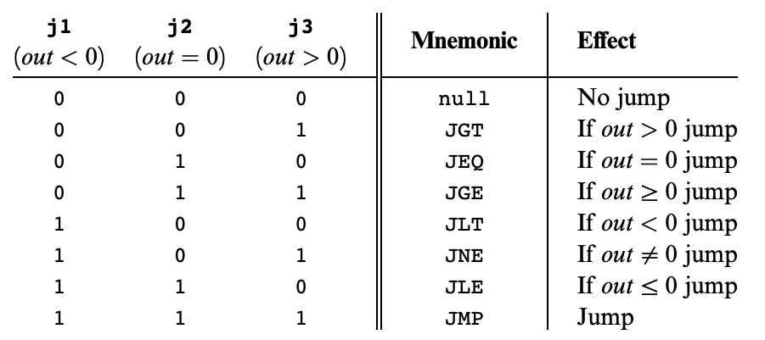
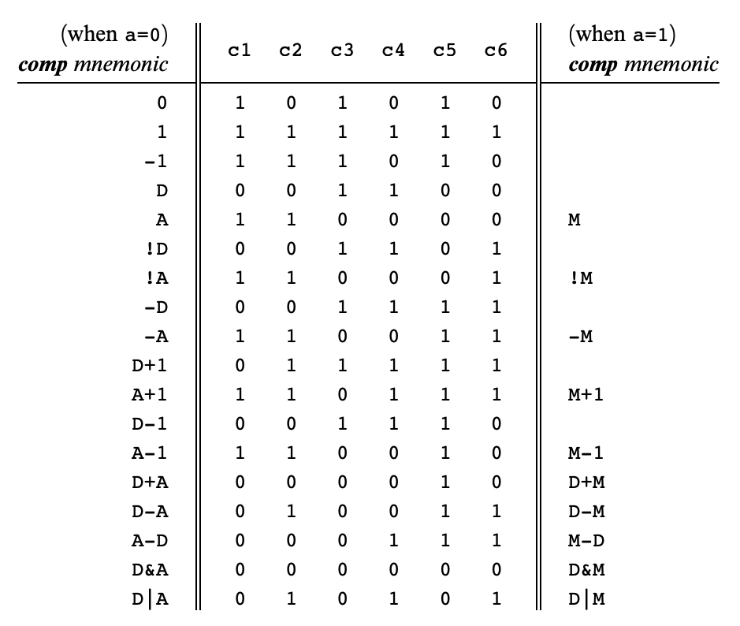
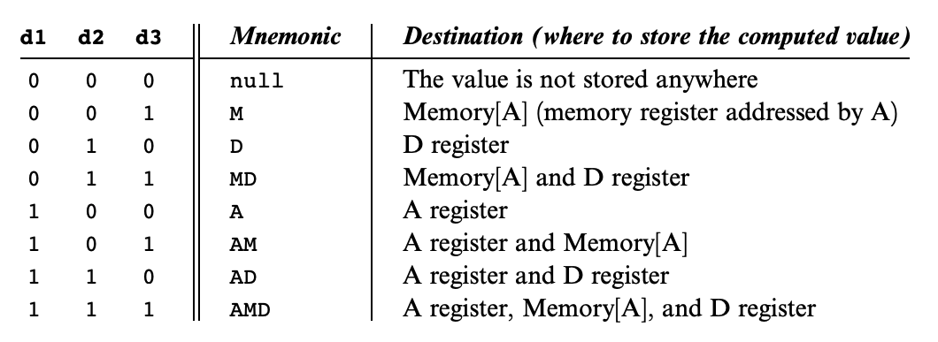
The Assembler’s Job
Look up each value in the corresponding table
D=D+1
1 1 1 0 1 1 1 1 1 0 1 0 0 0 0
Assemble
D+1
D
null
Notes:
We have the look up codes. Look up binary, plug all that binary in.
Pretty simple so far yeah?
WHY Assembler. Dan: Computers only understand 0s and 1s. But I write CODE. Assembly doesn’t correspond to chips. Could write 1s and 0s, would never get these right. Have fun debugging that.
1950s, write assemblers. Just get the assembly right.
Assembler task, the human can do that!
How do we as programmers program something that can make us to this red arrow? How can we characterize all the ways that we need to turn these parts of the instruction into these 1s and 0s
Essential that we need to get this right
Once we’re on the right side of the arrow. We’ve connected the hardware to the software. We have something that can physically be done in hardware.
All connected to the chips that you’ve built.

Slide 7
What Makes the Assembler’s Job Difficult?
Line #
Address
1
2
3
4
5
6
7
8
9
@12
D=A
@i
M=D // init
(LOOP)
@R3
MD = M-1
@LOOP
D;JGT
0
1
2
3
4
5
6
7
0000000000001100
1110110000010000
0000000000010000
1110001100001000
0000000000000011
1111110010011000
0000000000000100
1110001100000001
Assemble
Notes:
More complicated. Just 9 lines. What makes this hard? Take a minute. Read through, try to understand what code is doing.
What parts about this are not just a lookup? What might be a little more nonobvious for the assembler? Take a minute to see what the code is doing.
Like rosy picture that we have this direct translation. We have SYMBOLS. Don’t always have convenient translations. Bind loop to next line of code. Is the comment in the machine code? We have garbage that we have to think about. line 7. space on either side. Seem trivial. We know what they actually mean. Computer really difficult.
@12. How do I know this is meant if it’s twelve or some identifier? I have to encode that behavior.
Get a sense of why the assembler is difficult.
LINE 1 (@12): detect if that’s a number or a symbol
LINE 3 (@i): what address should i correspond to in RAM? has it been defined before?
LINE 4 (M=D // init): comments
LINE 5 ((LOOP)): what is LOOP? track line # → address
LINE 6 (@R3): built-in constants
LINE 7 (MD = M-1): whitespace
LINE 9 (D;JGT): detect optional parts of C instructions omitted

Slide 8
Difficulties for the Assembler
Three broad concerns:
Parsing
Recognizing type of each instruction and label, extracting relevant fields, skipping whitespace & comments
Symbols
Mapping from labels to instruction addresses, mapping from code symbols to RAM addresses, creating new symbols, corresponding line numbers to instruction addresses
Encoding
Converting relevant fields to binary values, converting symbol values to binary values
Notes:
Parsing. Source code → machine code. Can’t just get each instruction in some convenient way. Just have that string. String can be messy. Indentation, comment. Need to reliably throw away the garbage.
Symbols: so convenient for the programmer. But for the assembler, keep track of symbols. New symbol. Line of code, new area in RAM? Just a value?
Encoding: Easiest of the three concerns. Know what the instruction means, converting that binary instruction to binary values
Broad overview, not just specifically for assembler. 1) So you CAN understand assembler. 2) These concerns will not go away. Compiling or changing code in automatic way. These are three problems we will see in those contexts as well.

Slide 9
Bells and Whistles… Why Bother?
Tradeoff: Adding convenience for programmer makes it harder to build the Assembler
E.g., removing symbols from Hack would make Assembler much simpler, still possible to write all the same programs
But language would be far more annoying to use
Notes:
Why is it important we create these problems?
Tradeoff.
Could require Hack Assembly programmers to use numbers than symbols. P4. Don’t use R0 and R1. Don’t type in SCREEN or KEYBOARD, but use numbers. Thrown a fit.
That’s a difficult thing for a human to do. If we make language more annoying, we make the tools job easier.

Slide 10
Bells and Whistles… Why Bother?
Tradeoff: Adding convenience for programmer makes it harder to build the Assembler
E.g., removing symbols from Hack would make Assembler much simpler, still possible to write all the same programs
But language would be far more annoying to use
Don’t underestimate the importance of convenience
Put another way: Adding these extra features makes programmers more productive
Notes:
Convenience is so important. There is a productivity value. Twice as productive, you can produce twice as many programs, that investment is worth it. End goal of computers—human interfacing.
Any questions so far?

Slide 11
Parsing
Source code is just a giant string: we need to go character-by-character to understand that string
Parser presents iterator-like interface:
To “advance” one instruction:
Move cursor forward, skipping whitespace and comments, until next non-empty line (ending on a newline)
To “read” current instruction:
Throw away whitespace & comments
Determine what type of instruction
Pull relevant fields out
Notes:
Parser: Analyze a String. Take in some file. File contains a bunch of characters. Parse through that file. Convenient to present an interface. Iterate through each instruction. Parser. Provides abstraction that you are iterating through every instruction. Present interface. Very clean. Lots of different things to consider.
Assembly. One instruction per line. Java, don’t need to write in one line.
Parsing is not an easy problem at all.

Slide 12
Symbols: Labels
Keep symbol table, mapping symbols (strings) to their values (integers)
Initialize with built-in symbols
SYMBOL | VALUE
R0 | 0
R1 | 1
... | ...
R15 | 15
SCREEN | 16384
KBD | 24576
Notes:
Then, Assembler has a symbol table. Mapped somewhere, in assembly memory. Maybe a HashMap.
What are these translation?
Remembering what are the translations and use them later is just half the battle.
We need to POPULATE the table. nontrivial.

Slide 13
Symbols: Labels
Keep symbol table, mapping symbols (strings) to their values (integers)
Initialize with built-in symbols
Run through instructions, using this pseudocode:
SYMBOL | VALUE
R0 | 0
R1 | 1
... | ...
R15 | 15
SCREEN | 16384
KBD | 24576
If current line is (LABEL):
Add LABEL → next line number to symbol table
If current line is @LABEL:
Lookup LABEL in symbol table, insert value into A instruction
Notes:
Two general cases. Define a new symbol.
Creation and defining.
This isn’t as simple as it sounds.

Slide 14
Symbols: Labels
Problem: what if a label’s use comes before its definition?
Line #
1
2
3
4
5
@LOOP
0;JMP
D=M
(LOOP)
@var
Notes:
USE MIGHT COME BEFORE DEFN! Valid assembly! Comparison to Java.
How might we address this?
Go through it separately.
One pass down, and another pass.
Definitions, then usages.

Slide 15
Symbols: Labels
Problem: what if a label’s use comes before its definition?
Solution: Two passes
Pass 1: Populate symbol table by moving through file and ignoring anything that isn’t a (LABEL) line
Pass 2: Go through file again, ignoring (LABEL) lines, encoding C-instructions, and encoding A-instructions according to symbol table lookup
Line #
1
2
3
4
5
@LOOP
0;JMP
D=M
(LOOP)
@var
Notes:
Separate idea of definition and usage.
Any questions?
Key takeaway: Difficulties will persist, than just simple parser example.

Slide 16
Lecture Outline
Inside the Assembler
Producing Machine Code
Parsing, Symbols, Encoding
The Software Stack
Roadmap of Hardware and Software Components
Compilers Overview
Roadmap of Hardware and Software Components
Hack CPU Logic Example: writeM
Project 6 CPU Logic Exercise
Notes:
Talk about hardware, circuits, machine code. Moving to that layer above, jump through the barrier, from this point on, techniques for taking software. Grounding it in that machine language.
We’ve talked about the low-level computing parts of the course. Building a CPU
Look at the assembler, not just fundamental and important, technique.
BUT Assembly → machine code. Very reminiscent of the rest of the quarter. Sneak peek
Goal of today’s lecture: concepts behind assembler. Understand how the assembler actually works. Build on top, assuming we have an assembly language

Slide 17
Roadmap
SOFTWARE
HARDWARE
High-Level Language
Intermediate Language(s)
Assembly Language
Operating System
Machine Code
Computer
Memory
CPU
ALU
PC
Basic Logic Gates
NAND
Notes:
Broad look at what we’ve done so far and where we’re going.
First part of the course: Hardware focused. CPU, ALU, leaving the world behind. Going to software layer. Keeping that perspective.

Slide 18
Roadmap
SOFTWARE
HARDWARE
High-Level Language
Intermediate Language(s)
Assembly Language
Operating System
Machine Code
Computer
Memory
CPU
ALU
PC
Basic Logic Gates
NAND
Notes:
Green: what you’ve implemented/worked with. Won’t go as deep, but higher level overview. Survey of these higher level concepts. Talking about something, and interesting, definitely a class in the Allen School to learn more about that.

Slide 19
Roadmap
SOFTWARE
HARDWARE
High-Level Language
Intermediate Language(s)
Assembly Language
Operating System
Assembler
Machine Code
Computer
Memory
CPU
ALU
PC
Basic Logic Gates
NAND
Notes:
We just learned about the assembler! Going between assembly and machine code. This is really where the connection between the hardware and the software come into play. CSE 351. The hardware/software interface.

Slide 20
Roadmap
SOFTWARE
HARDWARE
High-Level Language
Focus for the rest of the course
Intermediate Language(s)
Assembly Language
Operating System
Assembler
Machine Code
Computer
Memory
CPU
ALU
PC
Basic Logic Gates
NAND
Notes:
Focus for the rest of the course. We talked about the assembler, we will learn more about the operating systems.
Won’t go as deep into each. Use it as a survey of some topics, lower-level computing topics. These are courses within the Allen School. Almost certainly in a class in the Allen School to learn more about that. Keep these things in mind.

Slide 21
Software
Overview
SOFTWARE
Java
Python
C/C++
Jack
High-Level Language
Compiler
Java Byte Code
Jack VM Code
Intermediate Language(s)
Compiler
(VM Translator)
x86, x86-64
ARM
RISC-V
HACK
Windows
macOS
Unix/Linux
Android
Hack OS
Assembly Language
Operating System
Assembler
Machine Code
Notes:
Most familiar with high-level courses in Java. Maybe experience in Python. Equivalent in Nand2Tetris is called Jack. We have intermediate language. Maybe Java Byte Code. Hardware agnostic languages. Multiple hardware platforms, more like assembly than like java code. Assembly languages. In CSE 351, we teach x86, Intel specification. RISC-V, open source.
We talked about Hack to machine code using assembler. You’ll debug a compiler and code in Jack in project 7!
Make hardware specification design open source, community open.
Peeling back the layers.
different OSs. What is an operating system? Why do we have it? What does it provide? Differences. Run Windows, what’s the difference between MacOS? OS, different ways to do the same thing. Each have benefits tradeoffs. Customizations, features, etc.

Slide 22
Lecture Outline
Inside the Assembler
Producing Machine Code
Parsing, Symbols, Encoding
The Software Stack
Roadmap of Hardware and Software Components
Compilers Overview
Roadmap of Hardware and Software Components
Hack CPU Logic Example: writeM
Project 6 CPU Logic Exercise
Notes:
Talk about hardware, circuits, machine code. Moving to that layer above, jump through the barrier, from this point on, techniques for taking software. Grounding it in that machine language.
We’ve talked about the low-level computing parts of the course. Building a CPU
Look at the assembler, not just fundamental and important, technique.
BUT Assembly → machine code. Very reminiscent of the rest of the quarter. Sneak peek
Goal of today’s lecture: concepts behind assembler. Understand how the assembler actually works. Build on top, assuming we have an assembly language

Slide 23
Software
Overview
SOFTWARE
Java
Python
C/C++
Jack
High-Level Language
Compiler
Java Byte Code
Jack VM Code
Intermediate Language(s)
Compiler
(Project 8)
Compiler
(VM Translator)
x86, x86-64
ARM
RISC-V
HACK
Windows
Mac
Unix/Linux
Android
Hack OS
Assembly Language
Operating System
Assembler
Machine Code
Notes:
C/C++ model, go straight from high-level language to assembly language. This is the approach that we use in Project 8. Working on a compiler for the Jack programming language.
TWO REASONS: Simpler, skip that intermediate step. Done in practice as well. Depends on language. Go from high-level language to assembly.

Slide 24
The Compiler: Goal
public int fact(int n) {
if (n == 0) {
return 1;
} else {
return n * fact(n - 1);
}
}
High-Level Language
(fact)
@R0
M=M+1
@R1
D=A
@ifbranch
D;JEQ
Assembly Language
Compiler
Notes:
Take a step back. What is the role of this box, the arrow? Compiler to assembly? Take code in source language, translate to target language. You are making a program that takes in some program and spits out another program. Blow my mind. Idea of a program. Take in some code. Java code. TWO WAYS.

Slide 25
The Compiler: Goal
public int fact(int n) {
if (n == 0) {
return 1;
} else {
return n * fact(n - 1);
}
}
High-Level Language
(fact)
@R0
M=M+1
@R1
D=A
@ifbranch
D;JEQ
Assembly Language
Theory Definition: a string, from the set of strings making up a language
Compiler
Notes:
Theory sense. Take in that string. String belongs to Java, fits certain constraints. String in Java matches. What we are analyzing. Theoretical aspect, much to dive into.

Slide 26
The Compiler: Goal
public int fact(int n) {
if (n == 0) {
return 1;
} else {
return n * fact(n - 1);
}
}
High-Level Language
(fact)
@R0
M=M+1
@R1
D=A
@ifbranch
D;JEQ
Assembly Language
Theory Definition: a string, from the set of strings making up a language
Practical Definition: a file containing a bunch of characters
Compiler
Notes:
More practical Actual computer: String. File on disk, bunch of characters. Interpret as Java source code. Spit out another String, contains a bunch of characters, it means something.
Overall goal. Big goal.
Finish Project 7, piece of code that is orange. High-level, spit out in Assembly language. Let’s split it up!

Slide 27
The Compiler: Implementation
public int fact(int n) {
if (n == 0) {
return 1;
} else {
return n * fact(n - 1);
}
}
High-Level Language
(fact)
@R0
M=M+1
@R1
D=A
@ifbranch
D;JEQ
Assembly Language
Scanner
Parser
Type Checker
Optimizer
Code Generator
Break string into discrete tokens:
etc.
Arrange tokens into syntax tree:
Verify the syntax tree is semantically correct
Rearrange the code to be more efficient
Convert the syntax tree to the target language
IF
(
ID(n)
+
==
NUM(0)
x
10
Notes:
Will not go into these in-depth, but there’s CSE 401 compilers! CSE 341, similar topics.
Problem, giant String of a whole bunch of characters. Meaningful string. First step is to give that String structure. Fact method. Tell a computer what a function means. complicated. Scanner and parser—giving meaning to the string in front of us.
Scanner: Tokenizing. Reason about certain words.
Parser: Take those tokens. Builds up a tree representing what we have in the code. Have the meaning.
Type Checker: Is this code correct? Valid Java, makes sense, type checking. Love from Java programming!
Optimizer: Rearrange to be more efficient. Multiple ways to write.
Code generator: Convert syntax tree to target language. Encode, concrete syntax, turn into abstract notion of function definition.
Overview of what is going on in the compiler. Goal is not to understand each of these, but rather to have a framework. QUESTIONS? Road ahead.

Slide 28
Lecture Outline
Inside the Assembler
Producing Machine Code
Parsing, Symbols, Encoding
The Software Stack
Roadmap of Hardware and Software Components
Compilers Overview
Roadmap of Hardware and Software Components
Hack CPU Logic Example: writeM
Project 6 CPU Logic Exercise
Notes:
Talk about hardware, circuits, machine code. Moving to that layer above, jump through the barrier, from this point on, techniques for taking software. Grounding it in that machine language.
We’ve talked about the low-level computing parts of the course. Building a CPU
Look at the assembler, not just fundamental and important, technique.
BUT Assembly → machine code. Very reminiscent of the rest of the quarter. Sneak peek
Goal of today’s lecture: concepts behind assembler. Understand how the assembler actually works. Build on top, assuming we have an assembly language

Slide 29
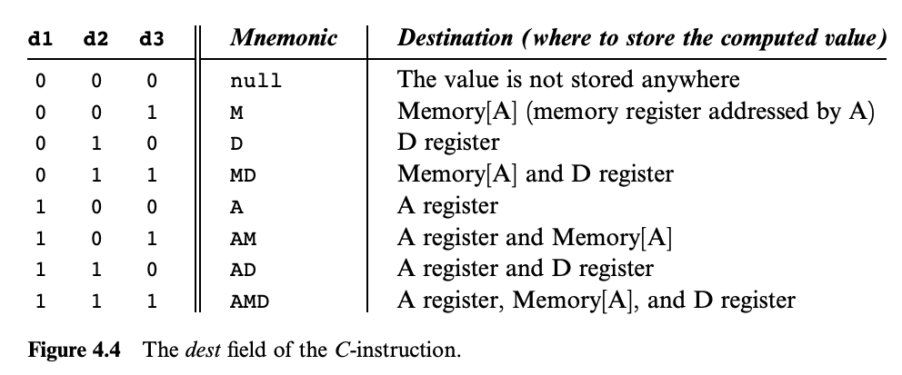
Hack CPU Logic Example: writeM
Example: Determine when writeM should be set to 1
Step 1: What do we pay attention to?
writeM is related to whether we write to memory or not
We need to look up the destination bits specification from Chapter 4

Slide 30
Hack CPU Logic Example: writeM
Example: Determine when writeM should be set to 1
Step 2: Determine logic for specification
Read the “Destination Specification” section of Chapter 4
Instruction bits: 1 1 1 a c1 c2 c3 c4 c5 c6 d1 d2 d3 j1 j2 j3
Notes:
D1 – A write to?
D2 – D write to?
D3 – writeM

Slide 31
Hack CPU Logic Example: writeM
Example: Determine when writeM should be set to 1
Step 2: Determine logic for specification
Read the “Destination Specification” section of Chapter 4
Instruction bits: 1 1 1 a c1 c2 c3 c4 c5 c6 d1 d2 d3 j1 j2 j3
Notes:
D1 – A write to?
D2 – D write to?
D3 – writeM

Slide 32
Hack CPU Logic Example: writeM
Example: Determine when writeM should be set to 1
Step 2: Determine logic for specification
Read the “Destination Specification” section of Chapter 4
Instruction bits: 1 1 1 a c1 c2 c3 c4 c5 c6 d1 d2 d3 j1 j2 j3
d3 determines if the output should be written to memory
Which bit of our instruction is that?
So writeM = instruction[3]?
Notes:
D1 – A write to?
D2 – D write to?
D3 – writeM

Slide 33
Hack CPU Logic Example: writeM
Example: Determine when writeM should be set to 1
What’s wrong with writeM = instruction[3]?
What happens if we have an A-instruction?
We only write to destinations in the case of a C-instruction
So, writeM = C-instruction & instruction[3]
Certain actions only occur on certain instruction types
You may have to include a check for instruction type in your logic
Notes:
D1 – A write to?
D2 – D write to?
D3 – writeM

Slide 34
Hack CPU Implementation: Logic Sub Chips
We provide three sub chips and tests that implement the control logic for the A Register, D Register, and PC
LoadAReg contains logic for loading the A Register
LoadDReg contains logic for loading the D Register
JumpLogic contains logic for determining if the PC should load, jump, or increment
Implement and test these first, then use them in your CPU implementation
Intended to help you narrow the scope of bugs

Slide 35
Lecture 13 Wrap-up
Midterm will be graded with feedback by Thursday (5/12)
Project 6: Mock Exam Problem & Building a Computer due this Thursday (5/12) at 11:59pm PDT
Thursday’s Lecture Reading: Compilers Overview: Scanning and Parsing
Please submit the mid-quarter feedback form if you haven’t already

